Slide 1
1
POWER ON DEVICE
2
TAP TOP BUTTON
3
CHOOSE MEASUREMENT TYPE
Luminometer
Luminometer
Luminometer
Tap top button for autoexposure
> Measurement
> Status - OK
> Choose calibration
> Autoexposure
> Timed exposure
> Back to main
POWERED OFF
Tap/hold middle button
for a timed measurement
ENSURE DEVICE IS UPRIGHT DURING MEASUREMENT!
4
MEASUREMENT IN PROGRESS
5
FINAL MEASUREMENT
Luminometer
Luminometer
MEASUREMENT IN PROGRESS
A: 1.23 +/- 0.23
B: 2.5 +/- 1.1
Elapsed: 8s Trgt: 30s
Final: Yes
A: 1.23 +/- 0.23
B: 2.5 +/- 1.1
Elapsed: 30s Trgt: 30s
> Clear and go to measurement screen
Tap bottom button after final measurement screen is shown to go back to measurement menu

Slide 2

1
POWER ON DEVICE
2
PLACE DEVICE IN 37C-40C INCUBATOR FOR 30 MINUTES
Luminometer
Luminometer
> Measurement
> Status - OK
> Choose calibration
After 30 minutes take the device out of the incubator.
POWERED OFF
3
4
HOLD MIDDLE BUTTON FOR 5s
TAP BOTTOM BUTTON
5
CONFIRM CUSTOM CALIBRATION
Luminometer
Luminometer
Luminometer
> Measurement
> Status - OK
> Choose calibration
> Restore default calibration
> Custom calibration
> Return to main menu
CAUTION
This will overwrite any existing custom calibration.
Are you sure?
YES – top button
NO – bottom button

Slide 3

6
PLACE DEVICE UPRIGHT IN 4C FRIDGE FOR 30 MINUTES
7
CALIBRATION
COMPLETE
Luminometer
Luminometer
After 30 minutes the final
measurement screen will be
displayed. Calibration
complete.
> Measurement
> Status - OK
> Choose calibration
Final: Yes
A: 1.23 +/- 0.23
B: 2.5 +/- 1.1
Elapsed: 30s Trgt: 30s
> Clear and go to measurement screen

Slide 4
1
HOLD BOTTOM BUTTON FOR 5s
2
TAP TOP BUTTON
3
POWERED OFF
Luminometer
Luminometer
Luminometer
> Measurement
> Status - OK
> Choose calibration
> Yes – top button
---
> No – bottom button
POWERED OFF
*This can be done from any screen (except during a measurement)

Slide 5
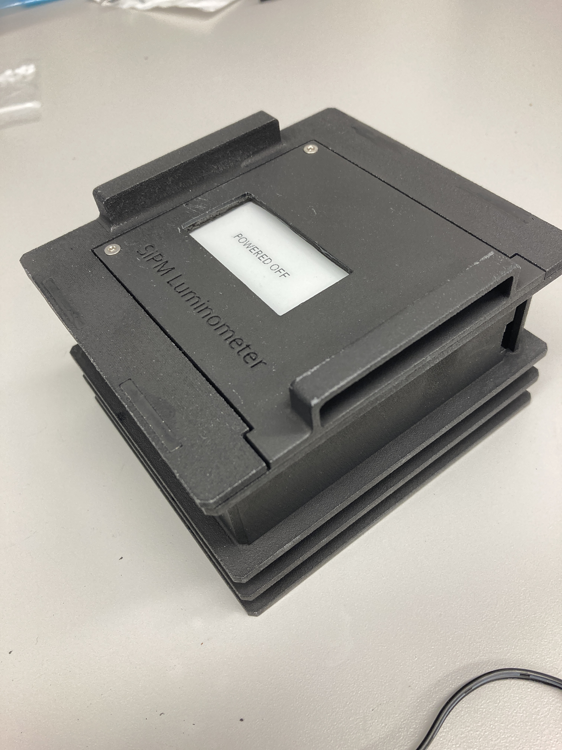
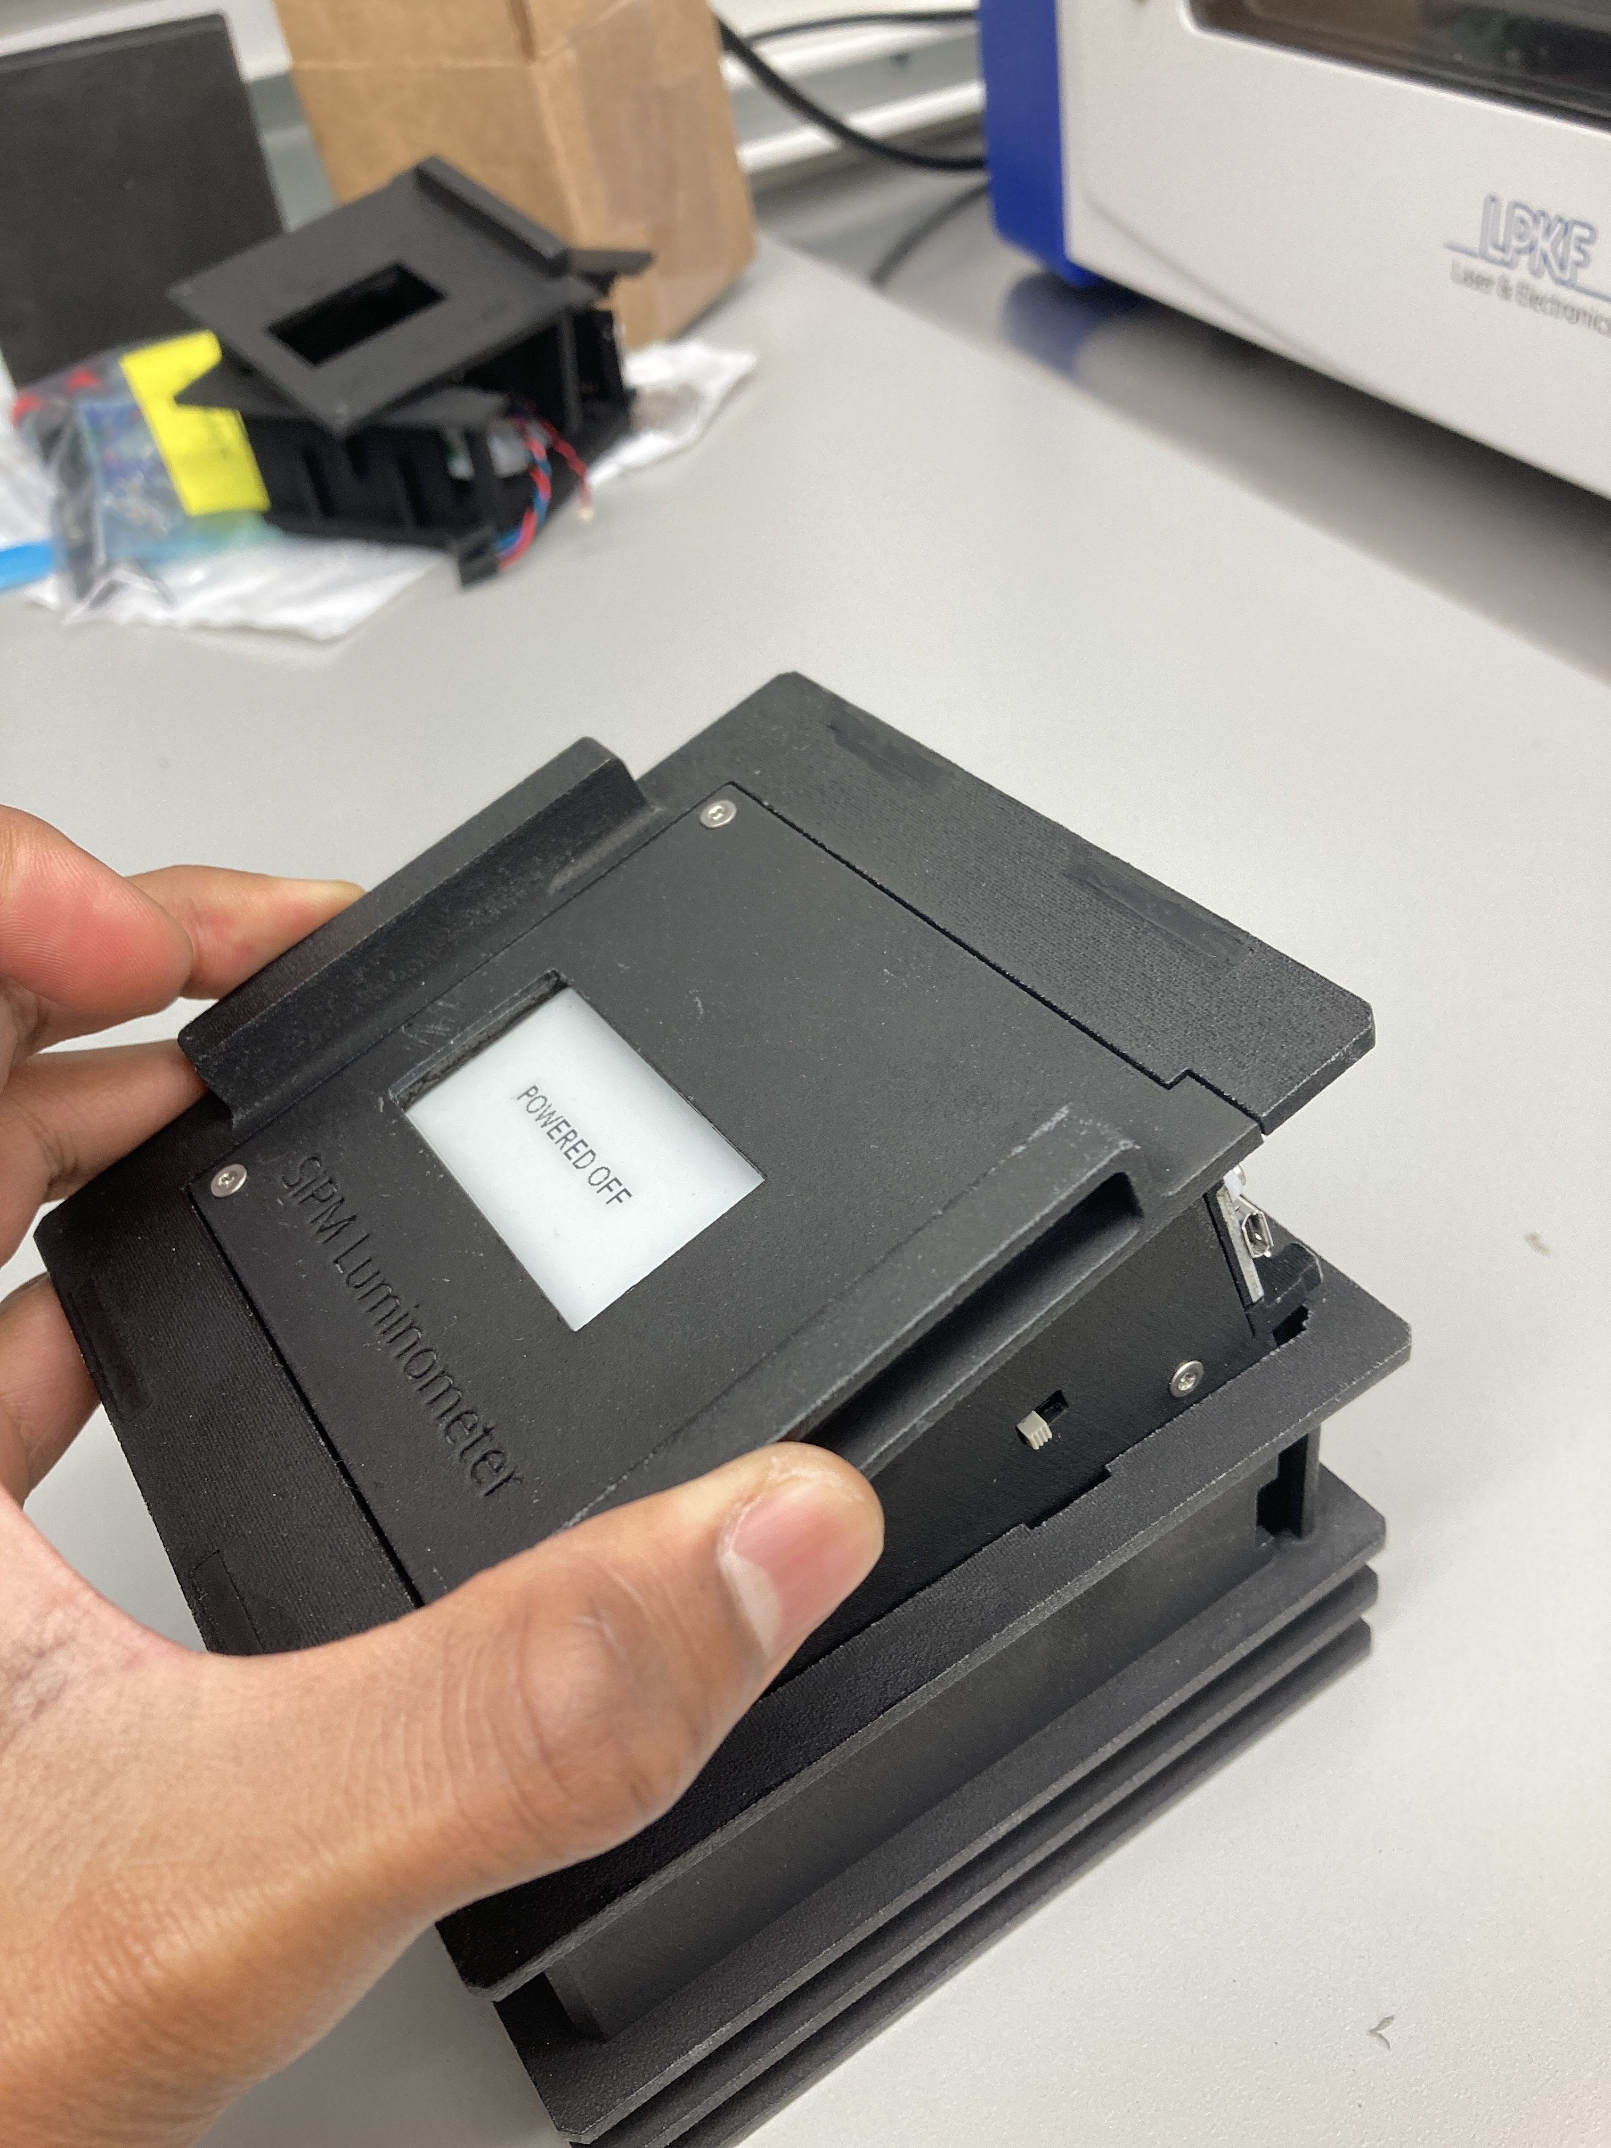
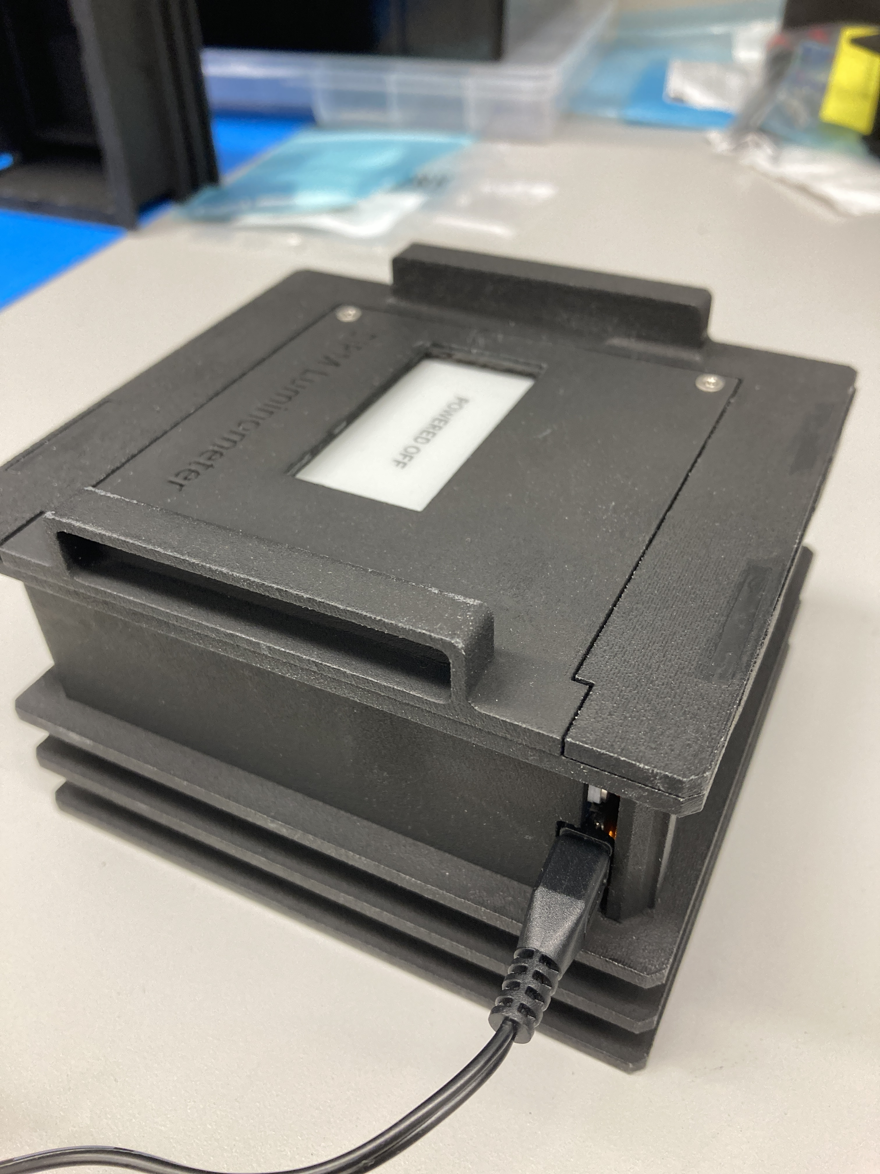
Charging Instructions
AFTER the device is powered off, pull the device out of its case
Flip this switch down (AS SHOWN)
Plug in the device with the provided charger. (You should see an orange LED light up inside!)

Slide 6
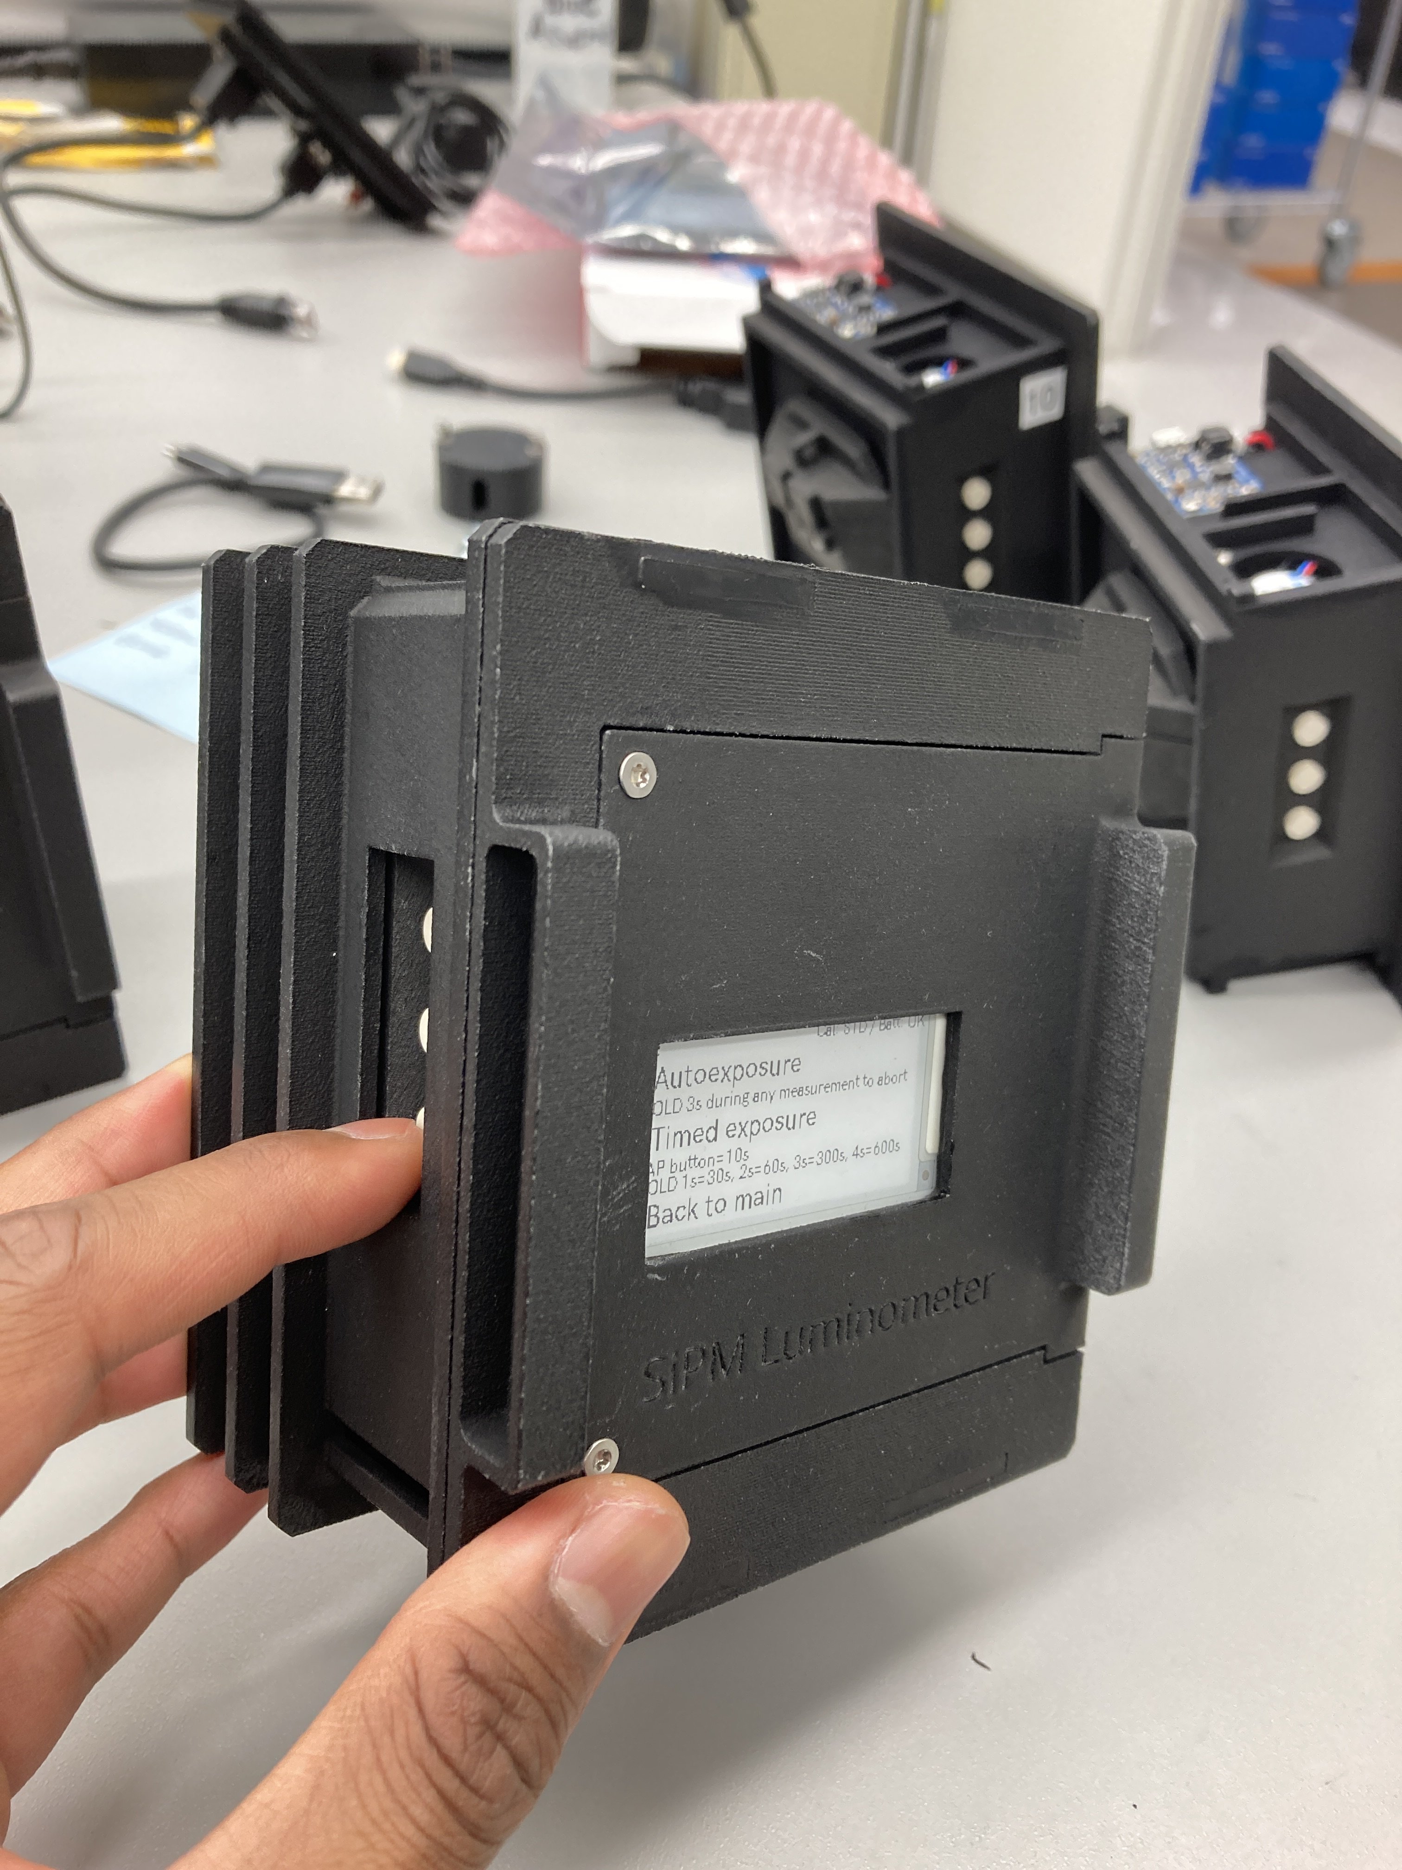
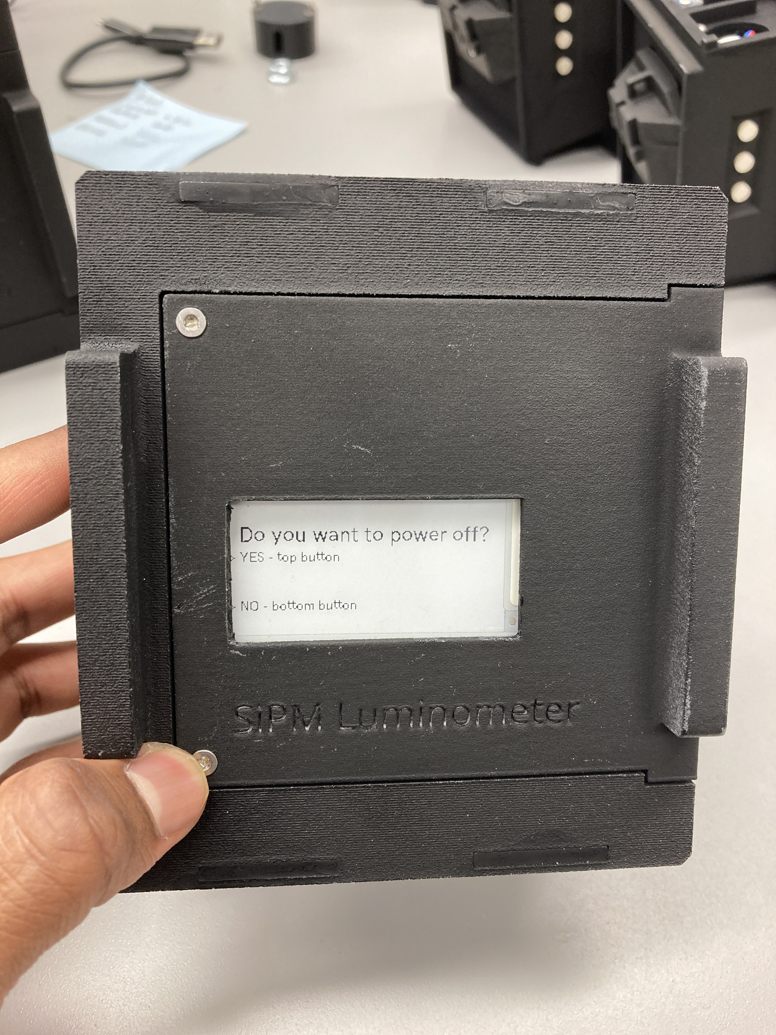
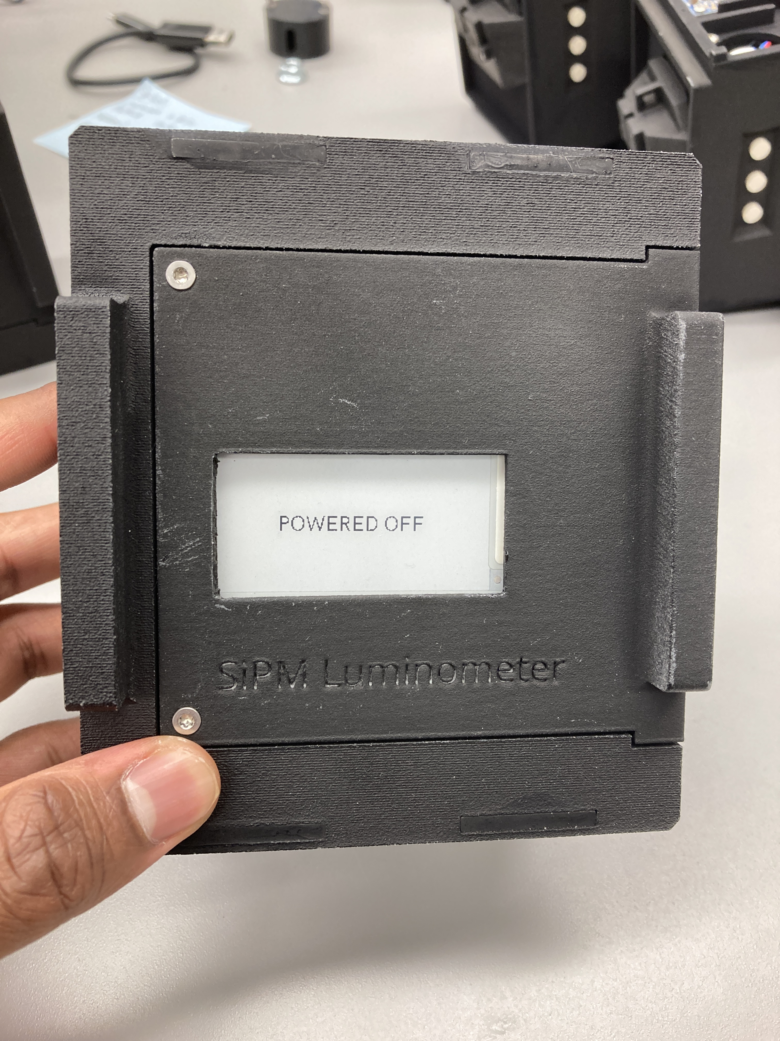
Powering off
Hold the BOTTOM button for 5 seconds from any screen (except during a measurement)
Confirm power off by tapping the TOP button
Wait for the power off screen. After 15 seconds, pull the device out of its housing and flip the power switch off.

